Slide 1




A Complete Guide to Programming in C++
Chapter 7 – Symbolic Constants and Marcos

Slide 2
Macros
C++ has a simple mechanism for naming constants or sequences of commands, that is for defining macros. You simply use the preprocessor’s #define directive.
This defines a macro called name. The preprocessor replaces name with substitutetext throughout the subsequent program.
EXAMPLE
For example, in the EXAMPLE, the name PI is replaced by the number 3.1415926536 throughout the program in the first phase of compilation.
There is one exception to this general rule: substitution does not take place within strings. For example, the statement cout << "PI"; outputs only PI and not the numerical value of PI

Slide 3
Symbolic Constants
Macros that are replaced by constants, such as the PI macro, are also known as symbolic constants. You should note that neither an equals sign nor a semicolon is used, as these would become part of the substitute text. You can use any macros you have previously defined in subsequent #define directives. The previous EXAMPLE uses the symbolic constant PI to define other constants.
Any preprocessor directive, and this includes the #define directive, must be placed in a line of its own. If the substitute text is longer than one line, you can terminate the line with a backslash \ and continue the substitute text in the next line, as is illustrated by the macro HEADER in the previous EXAMPLE.
The rules that apply to naming variables also apply to naming macros. However, it is standard practice to capitalize symbolic constants to distinguish them from the names of variables in a program.
Using macros makes a C++ program more transparent and flexible. There are two main advantages:
1. good readability: You can name a macro to indicate the use of the macro
2. easy to modify: If you need to change the value of a constant throughout a program, you simply change the value of the symbolic constant in the #define directive.

Slide 4


MACROS WITH PARAMETERS
It is possible to call macros with arguments. To do so, you must supply the appropriate parameters when defining the macro. The parameters are replaced by valid arguments at run time.
This defines a macro called SQUARE() with a parameter a. The name of the macro must be followed immediately by a left bracket. When the macro is called, for example
the preprocessor inserts the substitute text with the current arguments, which will be expanded as follows, in this case
This example also shows that you must be careful when using brackets to indicate parameters for macros. Omitting the brackets in the previous example, SQUARE, would cause the expression to be expanded as follows z = x + 1 * x + 1. The outer brackets in the definition ensure that even when the macro is used in a complex expression, the square is calculated before the result can be used for any further calculations.

Slide 5
Macros for Screen Control
EXAMPLE (simulating a bouncing ball)
The EXAMPLE uses macros to change the appearance of the screen. Peripheral devices, such as the screen or printers, can be controlled by special character sequences that normally begin with the ESC character (decimal 27, octal 033) and are thus known as escape sequences. A number of ANSI standard escape sequences exists for screen control.
CLS is a macro without any parameters that uses the escape sequence \033[2J to clear the screen. LOCATE is just one example of a macro with two parameters. LOCATE uses the escape sequence \033[z;sH to place the cursor at the position of the next screen output. The values z for the line and s for the column require decimal input with z=1, s = 1 representing the top left corner of the screen or window.
The ball is “thrown in” at the coordinates x = 2, y = 3 and bounces off the “floor” and the “walls.” In direction x (horizontally) the ball has a constant speed of dx = 1 or -1. In direction y (vertically) the ball is subject to a constant acceleration of 1, expressed as speed += 1

Slide 6

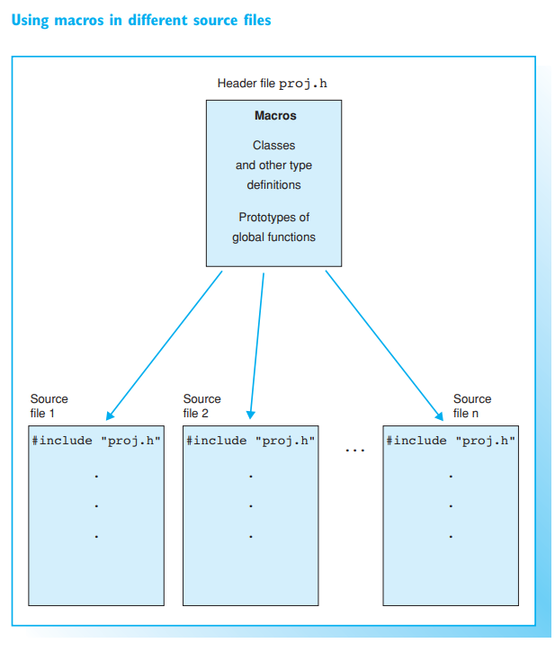

Working with the #define directive
You can place the #define directive in any line of a program as long as it is placed prior to using the macro. However, it is recommended to place all definitions at the beginning of the source file for ease of location and modification.
If you need to use the same macros in different source files, it makes sense to create a header file. You can then include the header file in your source files. This method also lends itself to large-scale software projects. The programmers working on the project then have access to the same set of macro definitions and other declarations.

Slide 7
Working with the #define directive
Macros with parameters can be called just like functions. You should note the following important differences, however:
Macros:
A macro definition must be visible to the compiler. The substitute text is inserted and re-compiled each time the macro is called. For this reason, a macro should contain only a few statements to avoid inflating the object file each time the macro is called. The speed of program execution will, however, improve since the program does not need to branch to sub-routines in contrast to normal function calls. This can become apparent when macros are used within loops, for example.
Side effects of macros are possible if the substitute text contains multiple instances of a parameter. The statement SQUARE( ++x ) expands to ((++x) * (++x)), for example. The variable x is incremented twice and the product does not represent the square of the incremented number.
Functions:
Functions are compiled independently. The linker then links them into the executable file. The program branches to the function whenever it is called, and this can reduce the speed of execution in comparison to a macro. However, the executable file will be shorter as it contains only one instance of the function code.
The compiler checks the argument types, and the side effects seen with macros cannot occur.
Inline functions, which are introduced in the chapter on functions, are an alternative to macros

Slide 8
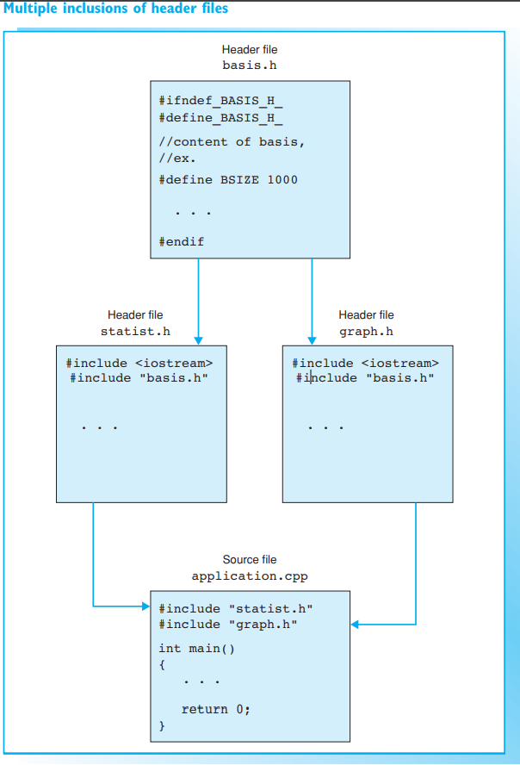

Conditional inclusion
A macro cannot simply be redefined. A macro definition is valid until it is removed by using an #undef directive. However, you do not need to supply the parameter list of a macro with parameters.
The macro MIN cannot be used after this point, but it can be defined again, possibly with a different meaning, using the #define directive.

Slide 9
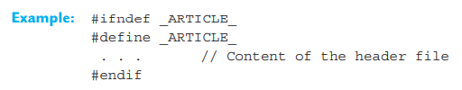
Conditional inclusion
You can use the preprocessor directives #ifdef and #ifndef to allow the compiler to check whether a macro has been defined
In the case of the #ifndef directive, the code block is compiled up to the next #endif only if the macro name has not been previously defined. On conditional inclusion else branching and nesting is also permissible. A macro definition does not need to include a substitute text to be valid.
A symbol without a substitute text is often used to identify header files and avoid multiple inclusion. If you have a header file named "article.h", you can identify the header by defining a symbol, such as _ARTICLE_, within that file.
If you have already included the header, _ARTICLE_ will already be defined, and the contents of the header file need not be compiled. This technique is also employed by standard header files.

Slide 10

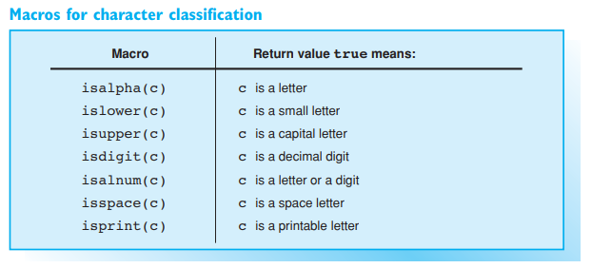
Standard macros for character manipulation
This section introduces macros that classify or convert single characters. The macros are defined in the header files ctype.h and cctype.
EXAMPLE: A filter that converts letters to capitals

Slide 11
Case conversion
You can use the macro toupper to convert lowercase letters to uppercase. If c1 and c2 are variables of type char or int where c1 contains the code for a lowercase letter, you can use the following statement c2 = toupper(c1); to assign the corresponding uppercase letter to the variable c2. However if c1 is not a lowercase letter, toupper(c1) returns the character “as is.”
The previous EXAMPLE reads standard input, converts any letters from lower to uppercase, and displays the letters. As toupper only converts the letters of the English alphabet by default, any national characters, such as accentuated characters in other languages, must be dealt with individually. A program of this type is known as a filter and can be applied to files. The macro tolower is available for converting uppercase letters to lowercase.

Slide 12
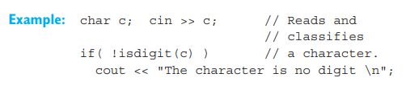
Testing Characters
A number of macros, all of which begin with is..., are available for classifying characters. For example, the macro islower(c) checks whether c contains a lowercase letter returning the value true, in this case, and false in all other cases.

Slide 13
Filter Programs
The previous EXAMPLE reads characters from standard input, processes them, and sends them to standard output. Programs of this type are known as filters. In the EXAMPLE, the loop while( cin.get(c)) { ... } is repeated while the test expression cin.get(c) yields the value true, that is, as long as a valid character can be read for the variable c. The loop is terminated by end-of-file or if an error occurs since the test expression cin.get(c) will then be false.

Slide 14
Redirecting standard input and output
EXAMPLE: A filter that numbers lines
How to call the program:
1. Redirecting the standard input:
lines < text.dat | more
This outputs the text file text.dat with line numbers. In addition, the data stream is sent to the standard filter more, which pauses screen output if the page is full.
2. Redirecting the standard output:
lines > new.dat
Here the program reads from the keyboard and adds the output to the new file new.dat. Please note, if the file already exists, it will be overwritten! You can use lines >> text.dat to append program output to the file text.dat. If the file text.dat does not already exist, it will be created. Type Ctrl+Z (DOS) or Ctrl+D (UNIX) to terminate keyboard input.

Slide 15
Using filter programs
The EXAMPLE is also a filter that reads a text and outputs the same text with line numbers. But in this case standard input is read line by line. while( getline(cin,line)) { ... } The test expression getline(cin,line) is true while a line can be read.
Filter programs are extremely useful since various operating systems, such as DOS, Win**, WinNT, and UNIX are capable of redirecting standard input and output. This allows easy data manipulation.
For example, if you need to output text.dat with line numbers on screen, you can execute the program lines by typing the following command: lines < text.dat
This syntax causes the program to read data from a file instead of from the keyboard. In other words, the standard input is redirected.
You can redirect input and output simultaneously: lines < text.dat > new.dat
In this example the contents of text.dat and the line numbers are stored in new.dat. The program does not generate any screen output

Slide 16
Exercises
Exercise 1
Please write
a. the macro ABS, which returns the absolute value of a number
b. the macro MAX, which determines the greater of two numbers.
In both cases use the conditional operator ?:
Add these macros to the header file "myMacros.h" and then test the macros.
EXTRA CREDIT: If your system supports screen control macros, also add some screen control macros to the header. For example, you could write a macro named COLOR(f,b) to define the foreground and background colors for the following output.

